Slide 1
Traffic Light Simulation
Batch-14
20B01A12H1-Tanguturi Bhavana 20B01A12H0 -Tamada Vidya Sri 20B01A0211 -Bandaru D L Tulasi 20B01A0213 - Bandarulanka Durga 20B01A5424 -Kolli Sneha Gowri

Slide 2
Description
Traffic Light Simulation in four way intersection road controls the flow of Traffic in each direction.

Slide 3
Team Contribution
20B01A12H1- classes like traffic lights,vehicles 20B01A12H0 - methods initialize() and repeat()
20B01A0211 -methods like updatevalues() and generatevehicles() 20B01A0213 - Main class
20B01A5424 - getting resources , defining the constants and finding the coordinates for the vehicles,prepared latex

Slide 4
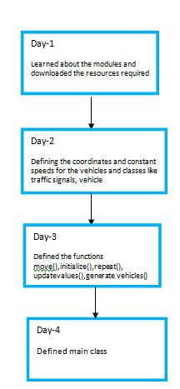
Day Wise Plan

Slide 5
Challenges Faced
faced a problem to calculate area equal to what we want a vehicle to look like in our final simulation.
the vehicles were colliding initially to resolve it we have introduced two variables named starting and stoping gap.
the output window wasn’t closing to resolve it we used pygame.quit();
sys.exit();

Slide 6
Technical Information
Languages : Python
Tools:JupyterNotebook
Packages Used: random ,time ,threading,pygame,sys

Slide 7
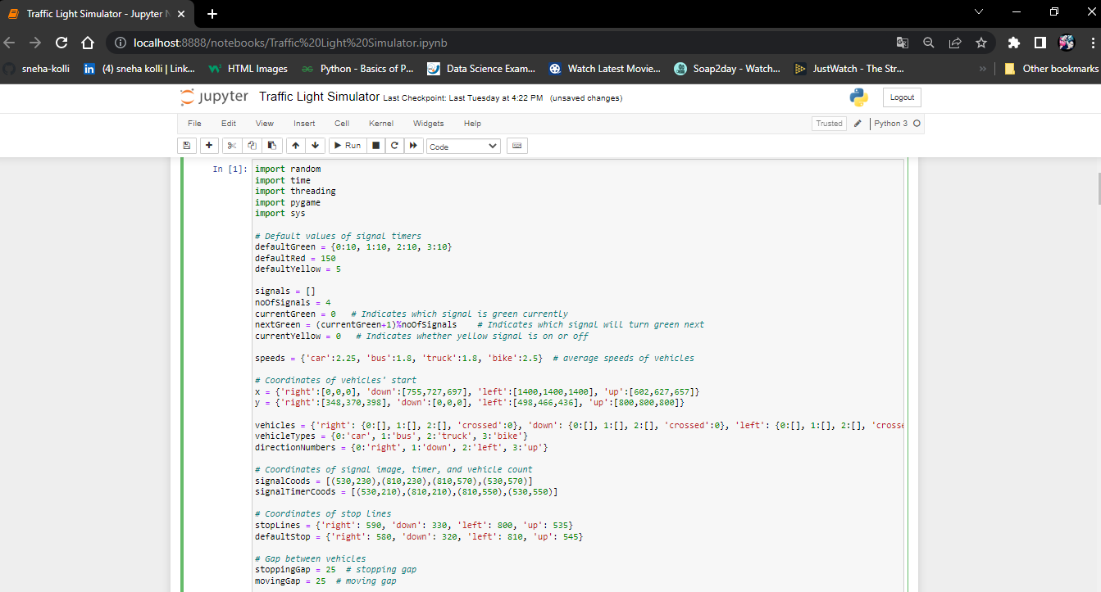
Screenshots

Slide 8
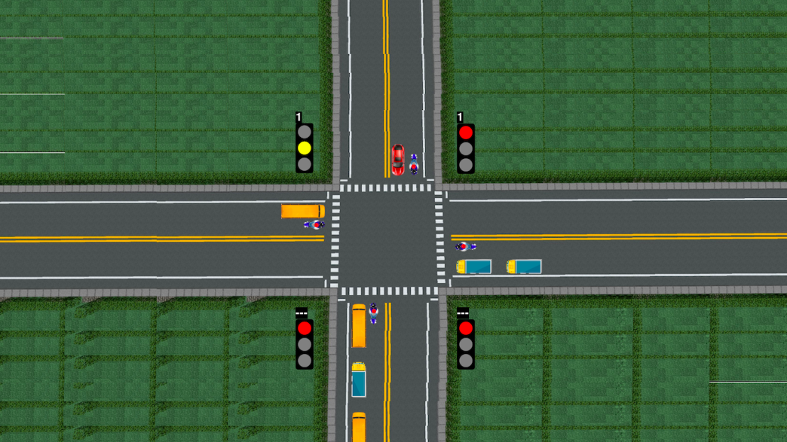

Slide 9
Statistics
- no of lines of code: 480
- no of classes:3
- no of functions:6

Slide 10
Git Links
Tanguturi S R N L Bhavana - https://gitlab.com/20b01a12h1 Tamada Vidya Sri -https://gitlab.com/20b01a12h0
Bandaru Devi Sri Lakshmi Tulasi- https://gitlab.com/bandarutulasi Bandarulanka Durga - https://gitlab.com/20b01a0213
Kolli Sneha Gowri - https://gitlab.com/20b01a5424

Slide 11
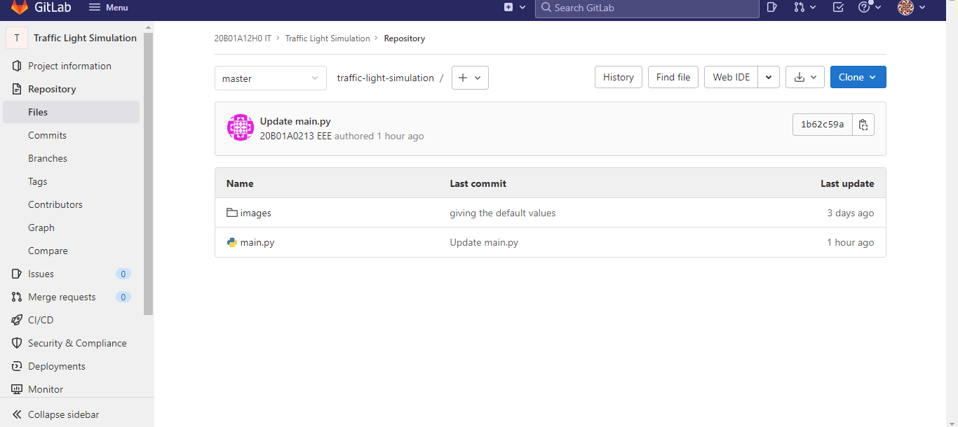
Git Repo
https://gitlab.com/20b01a12h0/traffic-light-simulation.git

Slide 12
Thank You

